Slide 1
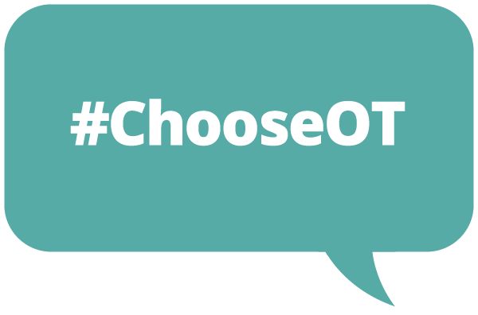



Occupational therapy
Careers talk

Slide 2


What does ‘occupation’ mean?

Slide 3
What does ‘occupation’ mean?
    Occupation refers to the everyday activities we do to look after ourselves and that give a sense of purpose to our lives.

Slide 4


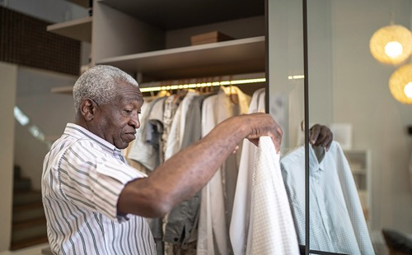
What does ‘occupation’ mean?
    Occupation refers to the everyday activities we do to look after ourselves and that give a sense of purpose to our lives.
What activities matter to you?

Slide 5
What do occupational therapists do?
      It’s all about problem-solving, creativity and working with an individual to:
    We try to look at the world through the eyes of other people, focus on the areas of life they find difficult or challenging, then help them find a way to overcome those challenges.
      Understand what they want to achieve
      Get to grips with the issues they face
      Work with them to find out what kind of support they need

Slide 6


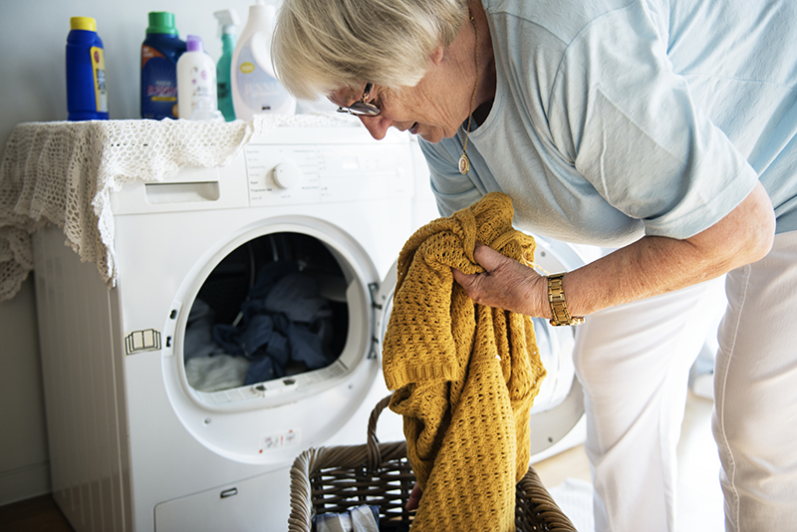
Who do occupational therapists help?
Who else could we work with?

Slide 7

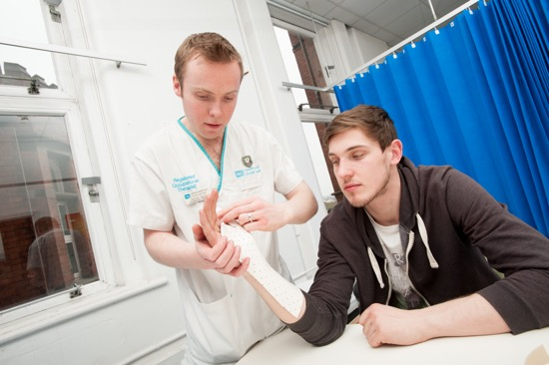
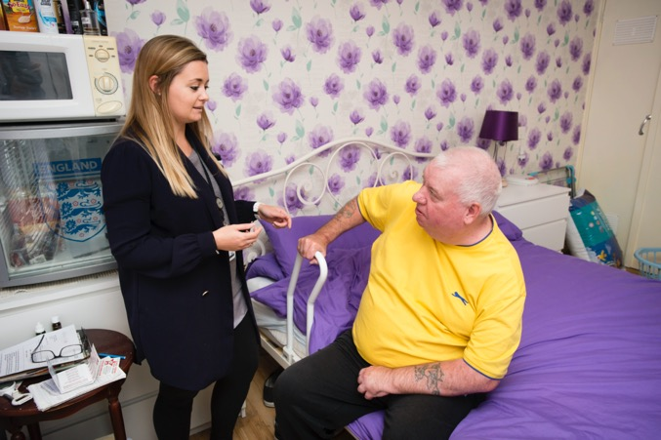
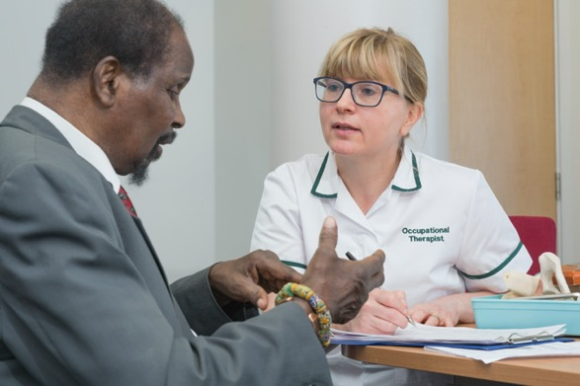
Where do occupational therapists work?
Where else could we work?
Notes:
Occupational therapists get to work with children and adults in a wide variety of places

Slide 8

My story
What’s my job?
Why did I choose to be an occupational therapist?
What’s my job?
Where do I work?
Why do I love my career?

Slide 9
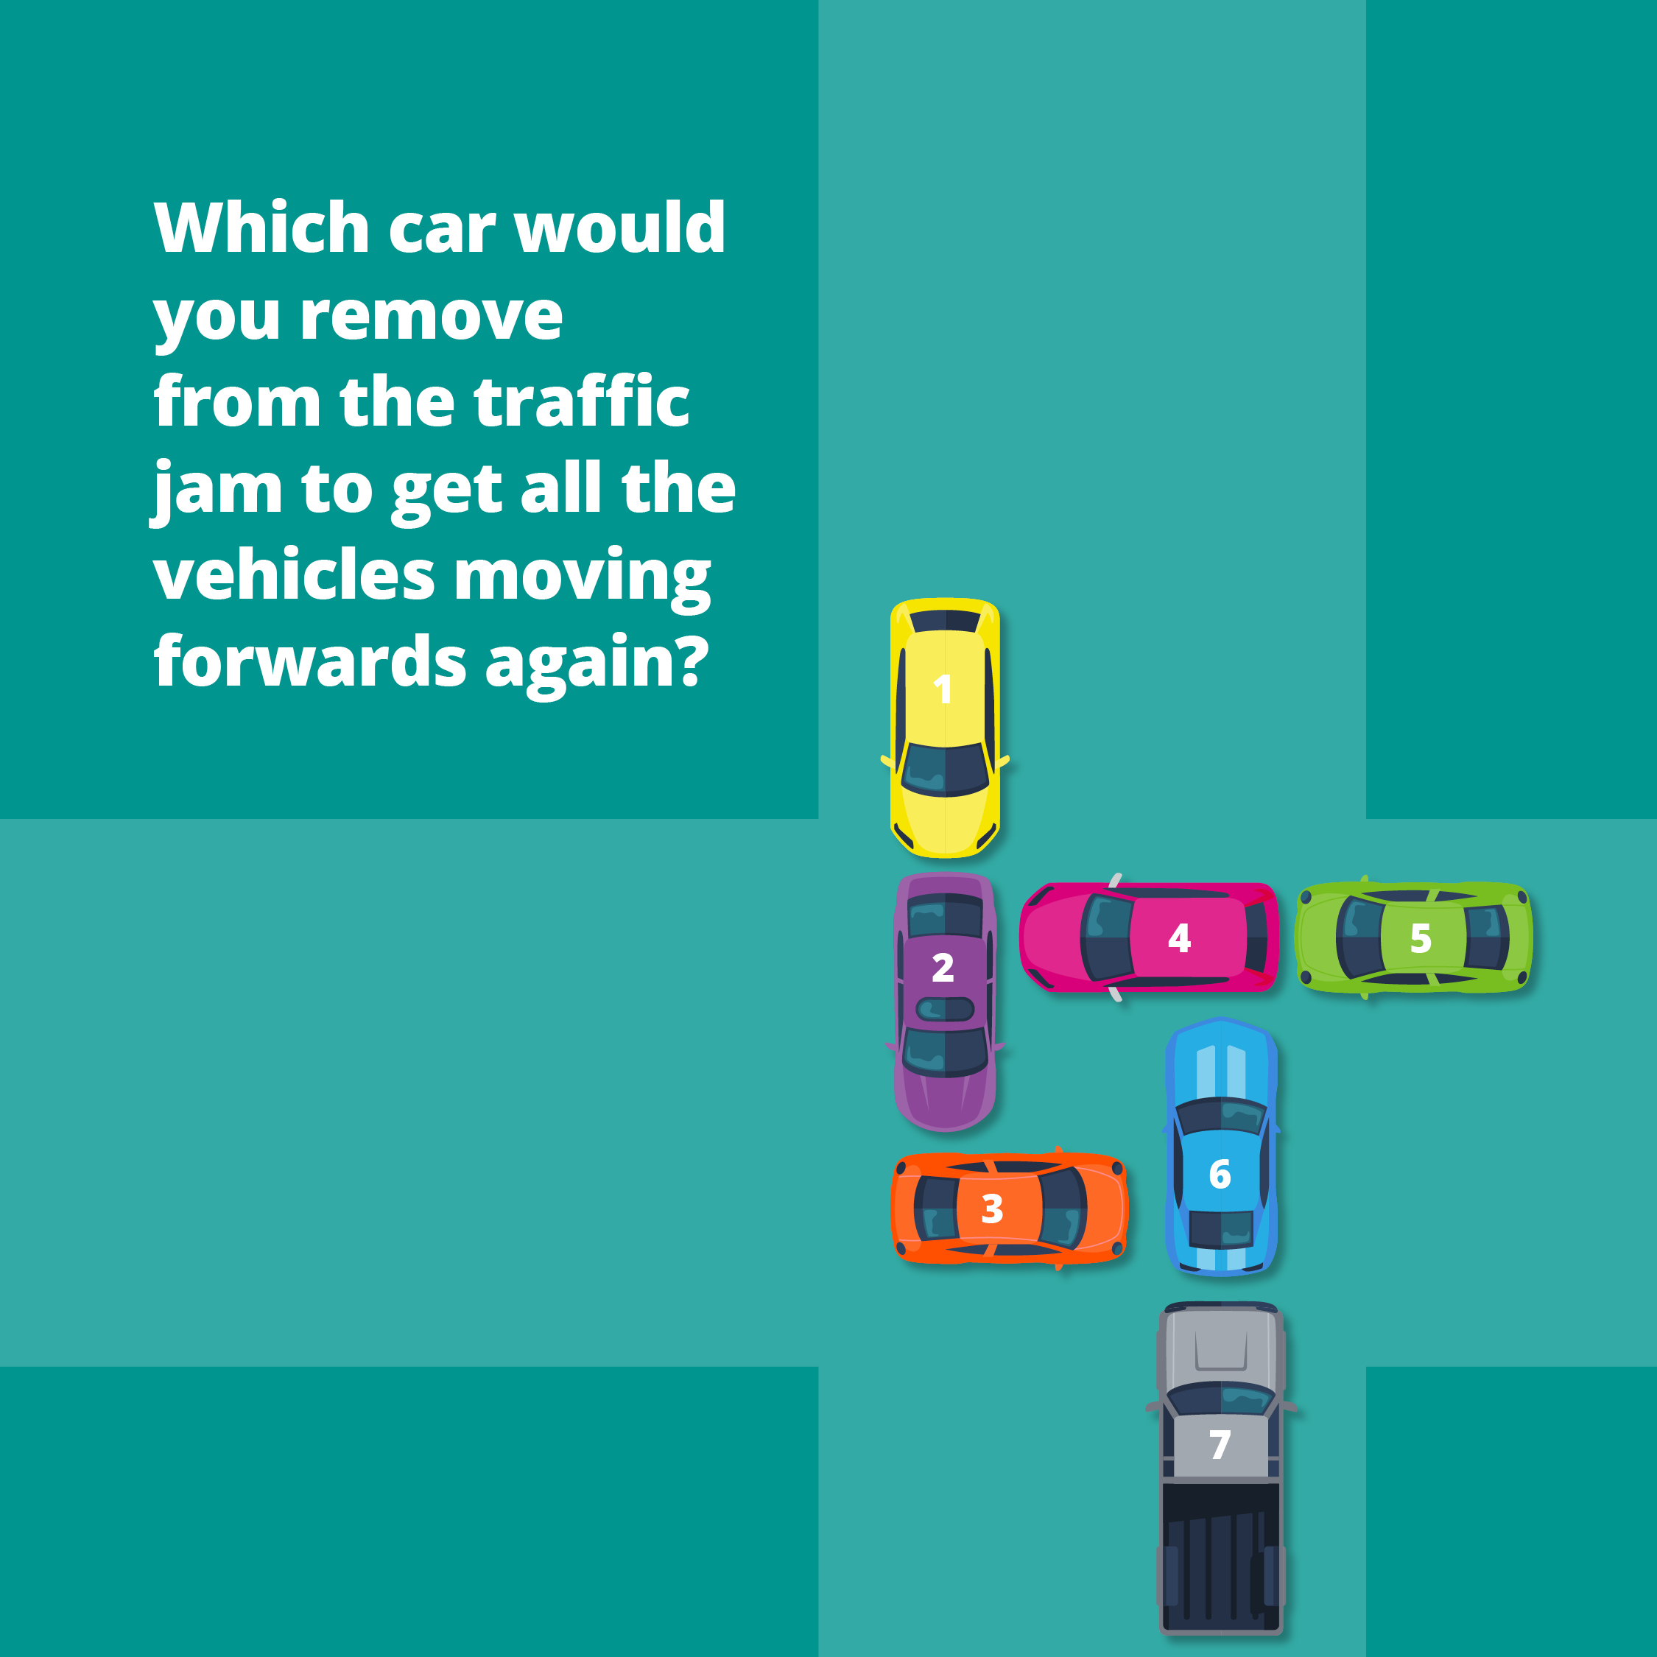
Could you be an occupational therapist?

Slide 10
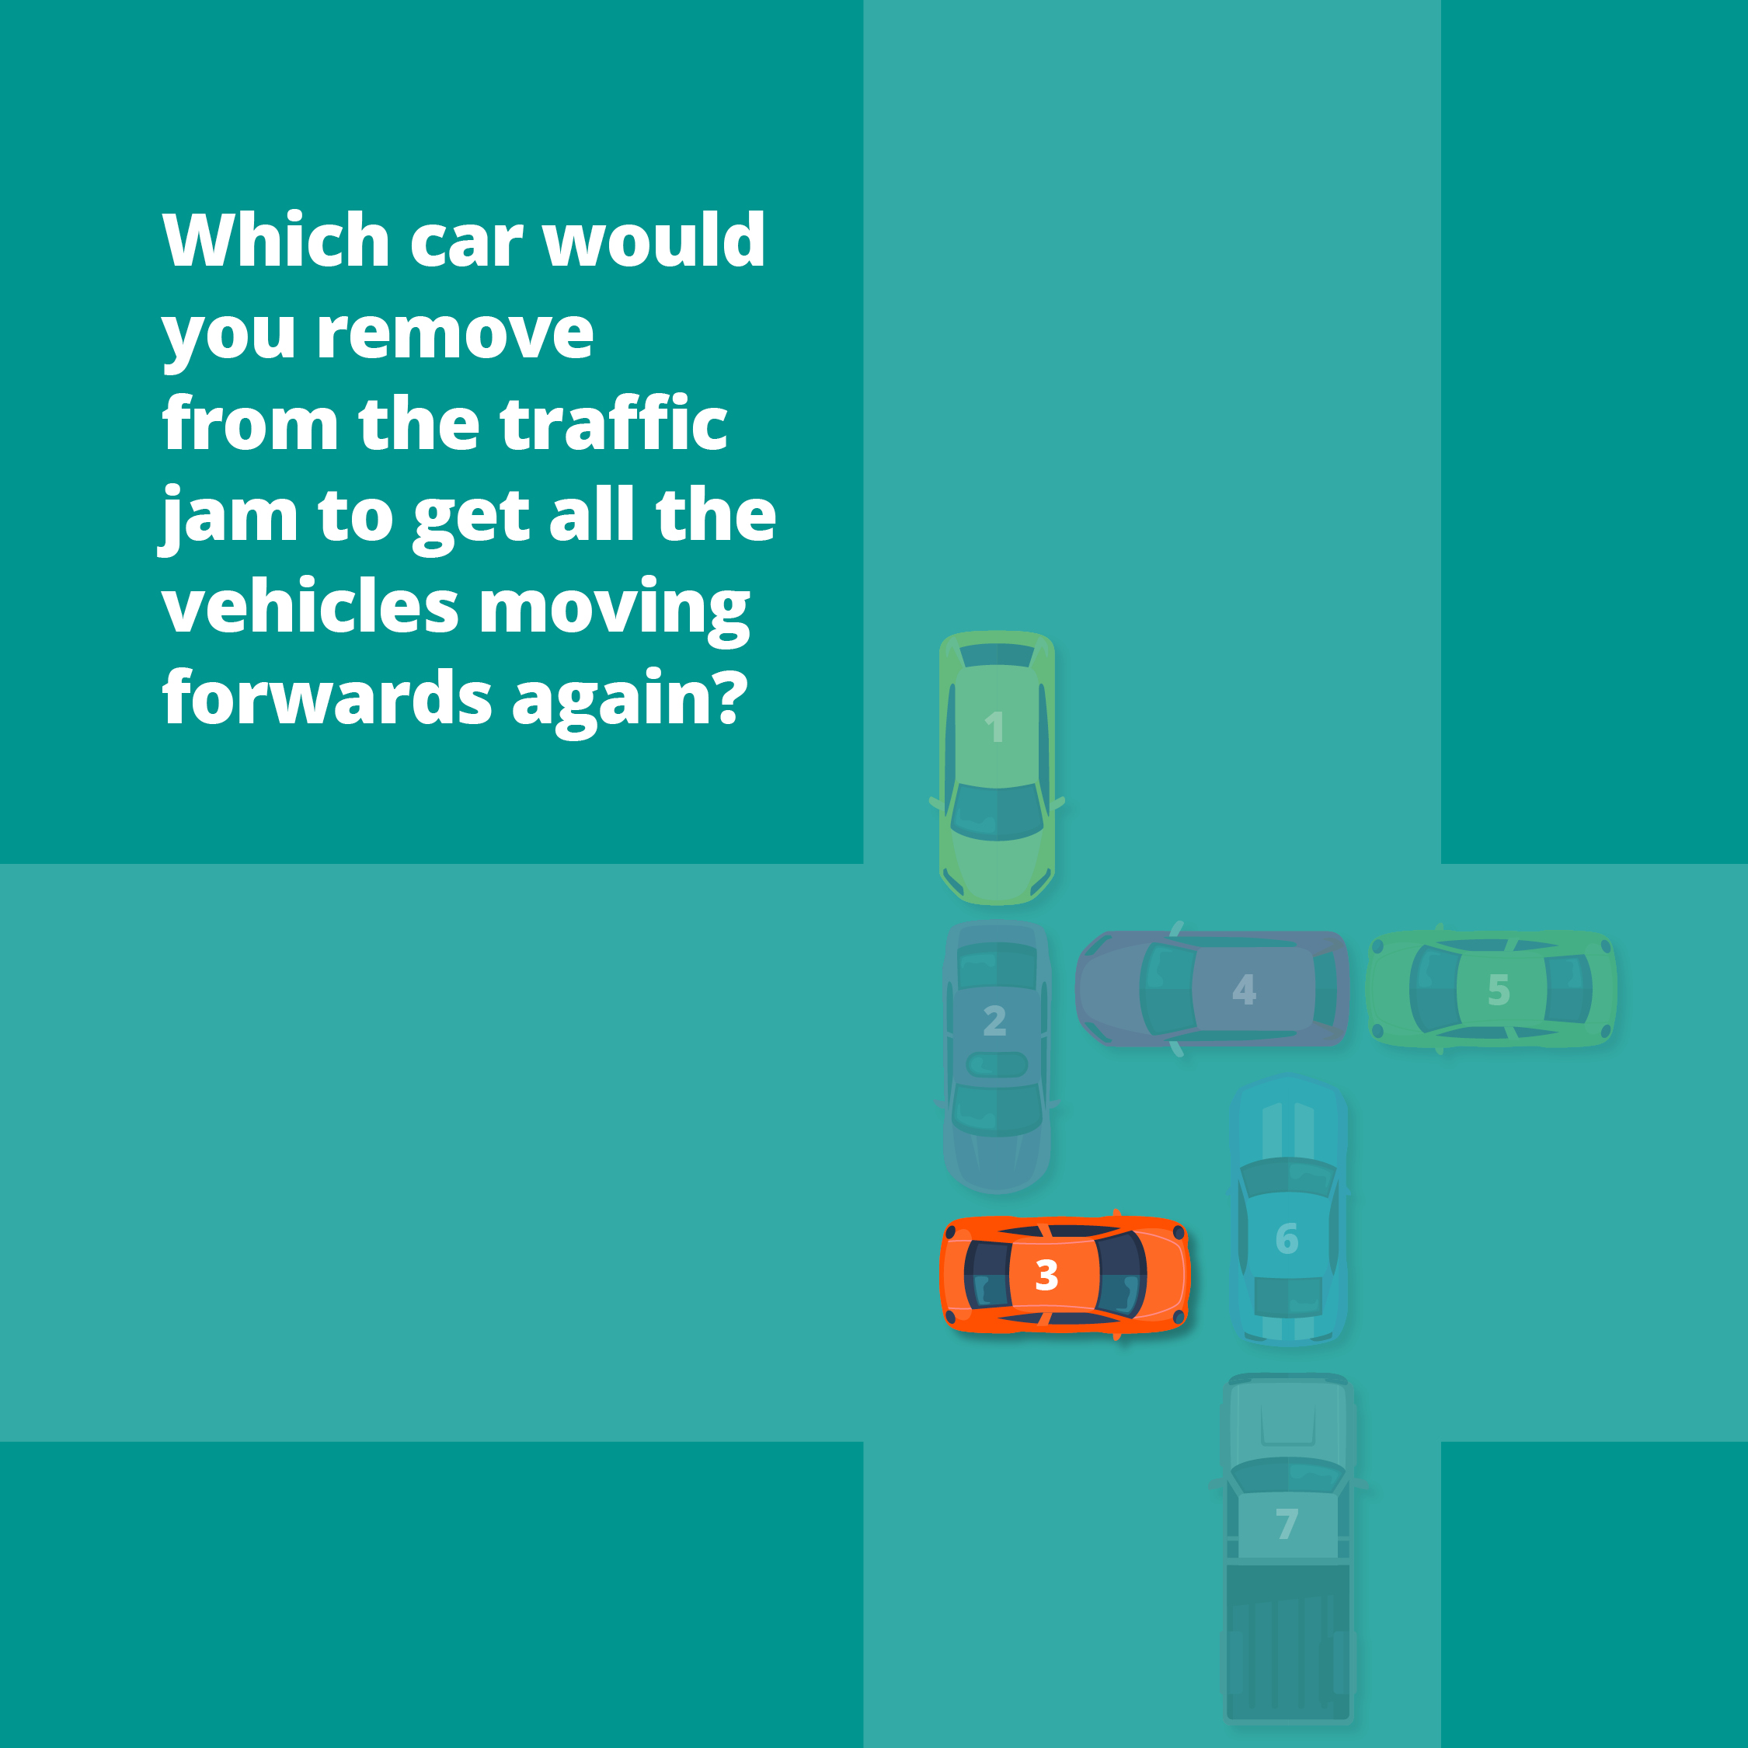
Could you be an occupational therapist?

Slide 11
Could you be an occupational therapist?
      Are you a problem solver?
    If your answer to any of these questions is ‘yes’, then occupational therapy could be the perfect career for you.
      Are you a people person?
      Do you get a buzz out of helping people?

Slide 12
How do you become an occupational therapist?
    There are two direct routes:
    Apprenticeship (degree level)
    Degree

Slide 13
What should I study
Step 2: A-levels, Welsh Baccalaureate, Scottish Highers or Irish Leaving Certificate
Not all Universities specify subjects.
Human biology, health and social care, psychology or social sciences would be good subjects.
A BTEC Diploma in a health and social care related subject or an access course are other options.
Step 1: GSCEs, or equivalent
English language and Maths are essential.
A science subject would also be good.

Slide 14
Visit the career website
  ChooseOT.co.uk

